Slide 1
Install NodeJS
And update the npm installer

Slide 2
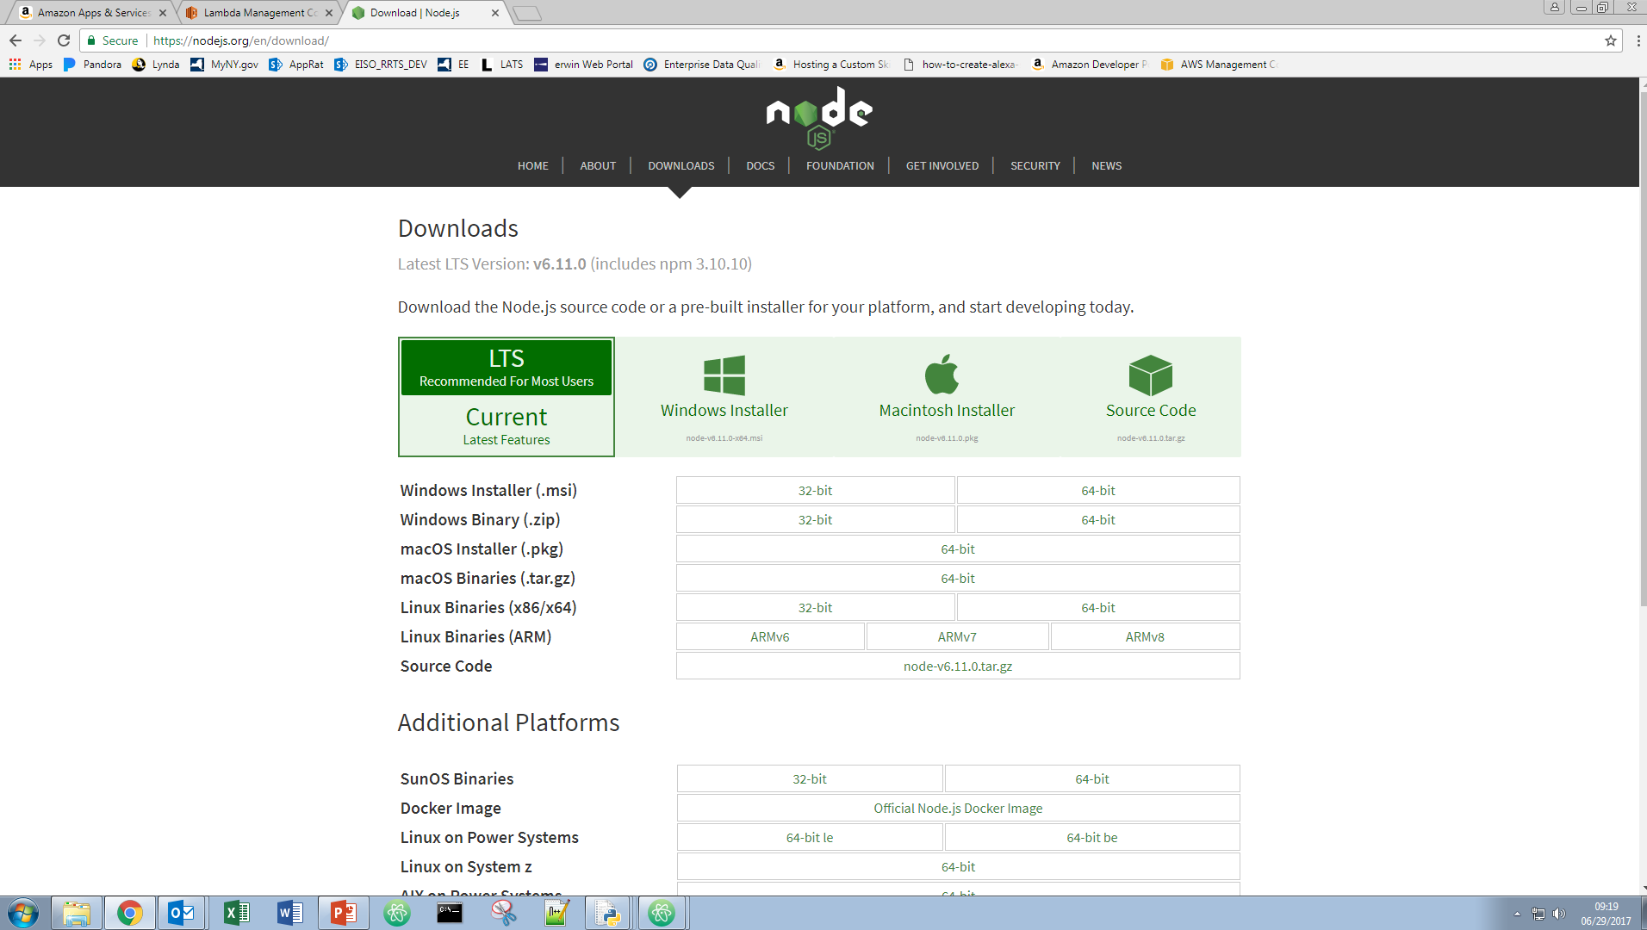
Install NodeJS
Go to https://nodejs.org/en/download/
Click Windows Installer
Start the installation exe file and follow the steps

Slide 3
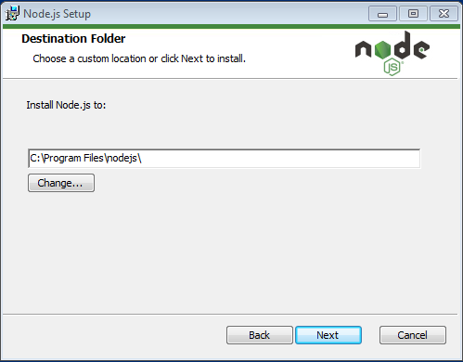
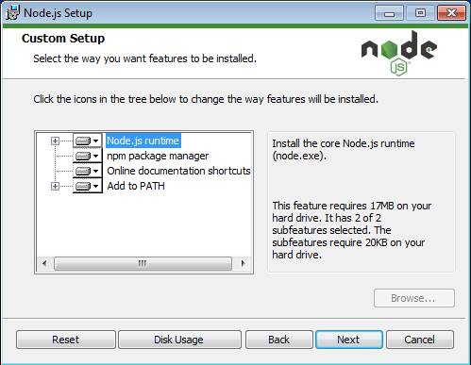
Start the Installation EXE File and Follow the Steps

Slide 4
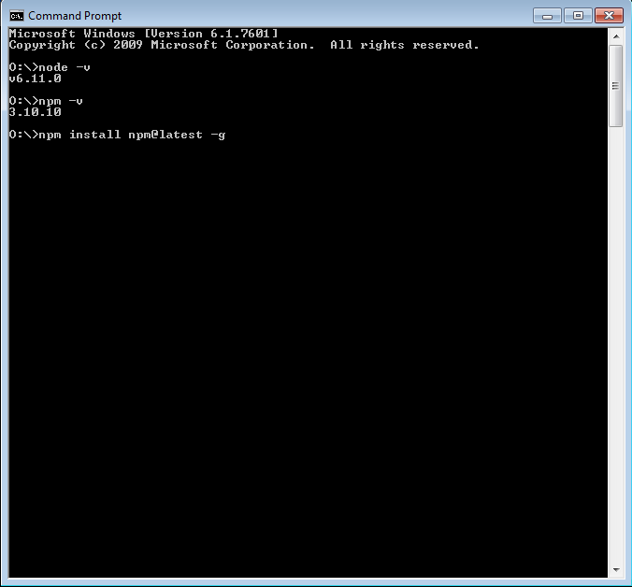
Check if NodeJS is Updated
Use node –v to check the NodeJS Version. It should be higher than v0.10.32
Use npm –v to check the NPM Version. It should be higher than 2.1.8
If the npm is not up to date use the npm install npm@latest –g command to install the latest npm. Note: There are many version changes of npm it may be wise to update it anyway.

Slide 5
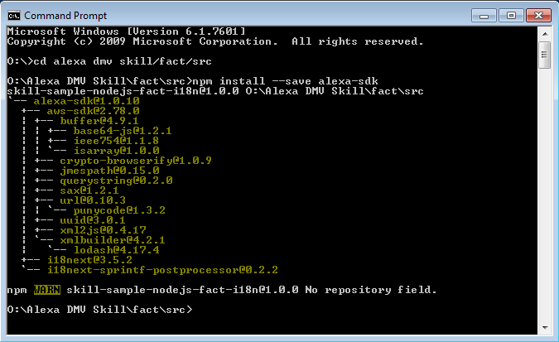

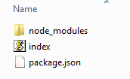
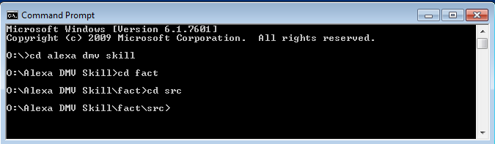
Install the Alexa-SDK Package
Use the cd command to navigate to the folder with your index.js file. It will be like the path you see displayed in Windows Explorer. Then use:
npm install --save alexa-sdk
You can use one command with “/” to navigate through or several commands.
Multiple Commands
Single Commands
Before Install
After Install

